Slide 1
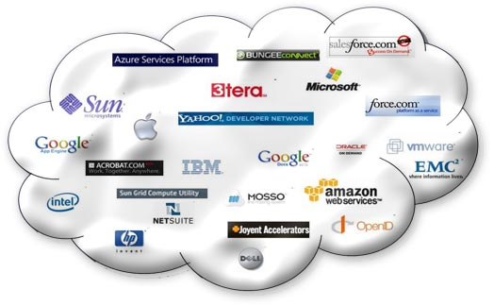
Web Based Application
Cloud services, in the form of centralized web-based applications, also appeal
to the IT professional. One instance of an application hosted in the cloud is
cheaper and easier to manage than individual copies of similar software
installed on each user’s desktop PC. Upgrading a cloud app only has to be
done one time, where upgrading traditional software has to be done for each
PC on which that software is installed. Then, of course, we have the promise
of cloud-enabled collaboration, which just can’t be done with traditional desktop apps.

Slide 2
Why Develop Web-Based Applications?
They must deliver adequate computing power and data storage to all users within the company.
Must be done, of course, within a set budget.
to meet peak needs or to add capacity for new users.

Slide 3
Essentials of Creating Web-Based Applications
Web based application development is not just the way to save money and time.
organizing more effective collaboration process with your colleagues, clients or partners, that makes web based application development.
Web based application development includes database integration, intra- and extranet applications deployment.

Slide 4
Pros and Cons of Cloud Computing Advantages
Lower-Cost Computers for Users
Improved Performance
Lower IT Infrastructure Costs
Fewer Maintenance Issues
Lower Software Costs
Instant Software Updates
Increased Computing Power
Unlimited Storage Capacity

Slide 5
Increased Data Safety
Improved Compatibility Between Operating Systems
Improved Document Format Compatibility
Easier Group Collaboration
Universal Access to Documents
Latest Version Availability
Removes the Tether to Specific Devices

Slide 6
Disadvantages of Cloud Development
Is it secure?
if the cloud computing host goes offline.
(Amazon’s EC2 service suffered a massive outage on February 15, 2008 )
Platform go down and your data disappear
third-party cloud platform
no other physical backup, that data can be at risk

Slide 7
Pros and Cons

Slide 8
Types of Cloud Service Development - Iaas - Paas - Saas

Slide 9
What is Software as a Service? (SaaS)
SaaS is a software delivery methodology that provides licensed multi-tenant access to software and its functions remotely as a Web-based service.
Usually billed based on usage
Usually multi tenant environment
Highly scalable architecture

Slide 10
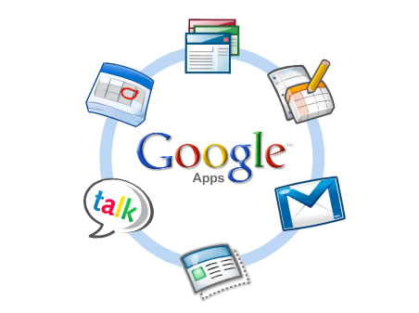
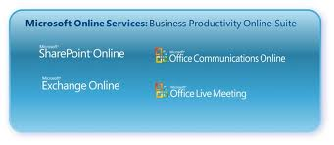
SaaS Examples

Slide 11
Infrastructure as a Service (IaaS)
IaaS is the delivery of technology infrastructure as an on demand scalable service
Usually billed based on usage
Usually multi tenant virtualized environment
Can be coupled with Managed Services for OS and application support

Slide 12
IaaS Examples

Slide 13
Platform as a Service (PaaS)
PaaS provides all of the facilities required to support the complete life cycle of building and delivering web applications and services entirely from the Internet.
Typically applications must be developed with a particular platform in mind
Multi tenant environments
Highly scalable multi tier architecture

Slide 14
PaaS Examples

Slide 15
DEVELOPING CLOUD SERVICES

Slide 16
Web Services
A Web service is a method of communication between two electronic devices over a network.
A web service is an application that operates over a network.
a web service is an API that can be accessed over
the Internet.

Slide 17
Advantages of web services
faster (and lower-cost) application development,
leaner applications, and
reduced storage and bandwidth demands.
A good example of web services are the mashups created by users of the Google Maps API.

Slide 18
What are Web Services?
Web services are application components
Web services communicate using open protocols
Web services are self-contained and self-describing
Web services can be discovered using UDDI
Web services can be used by other applications
XML is the basis for Web services

Slide 19
How Does it Work?
The basic Web services platform is XML + HTTP.
The HTTP protocol is the most used Internet protocol.
Web services platform elements:
SOAP (Simple Object Access Protocol)
UDDI (Universal Description, Discovery and Integration)
WSDL (Web Services Description Language)

Slide 21
The General Process of Engaging a Web Service
1) the requester and provider entities become known to each other (or at least one becomes know to the other)
(2) the requester and provider entities somehow agree on the service description and semantics that will govern the interaction between the requester and provider agents
(3) the service description and semantics are realized by the requester and provider agents
4) the requester and provider agents exchange messages, thus performing some task on behalf of the requester and provider entities

Slide 22
Interoperability has Highest Priority
When all major platforms could access the Web using Web browsers, different platforms could interact. For these platforms to work together, Web-applications were developed.
Web-applications are simple applications that run on the web. These are built around the Web browser standards and can be used by any browser on any platform.

Slide 23
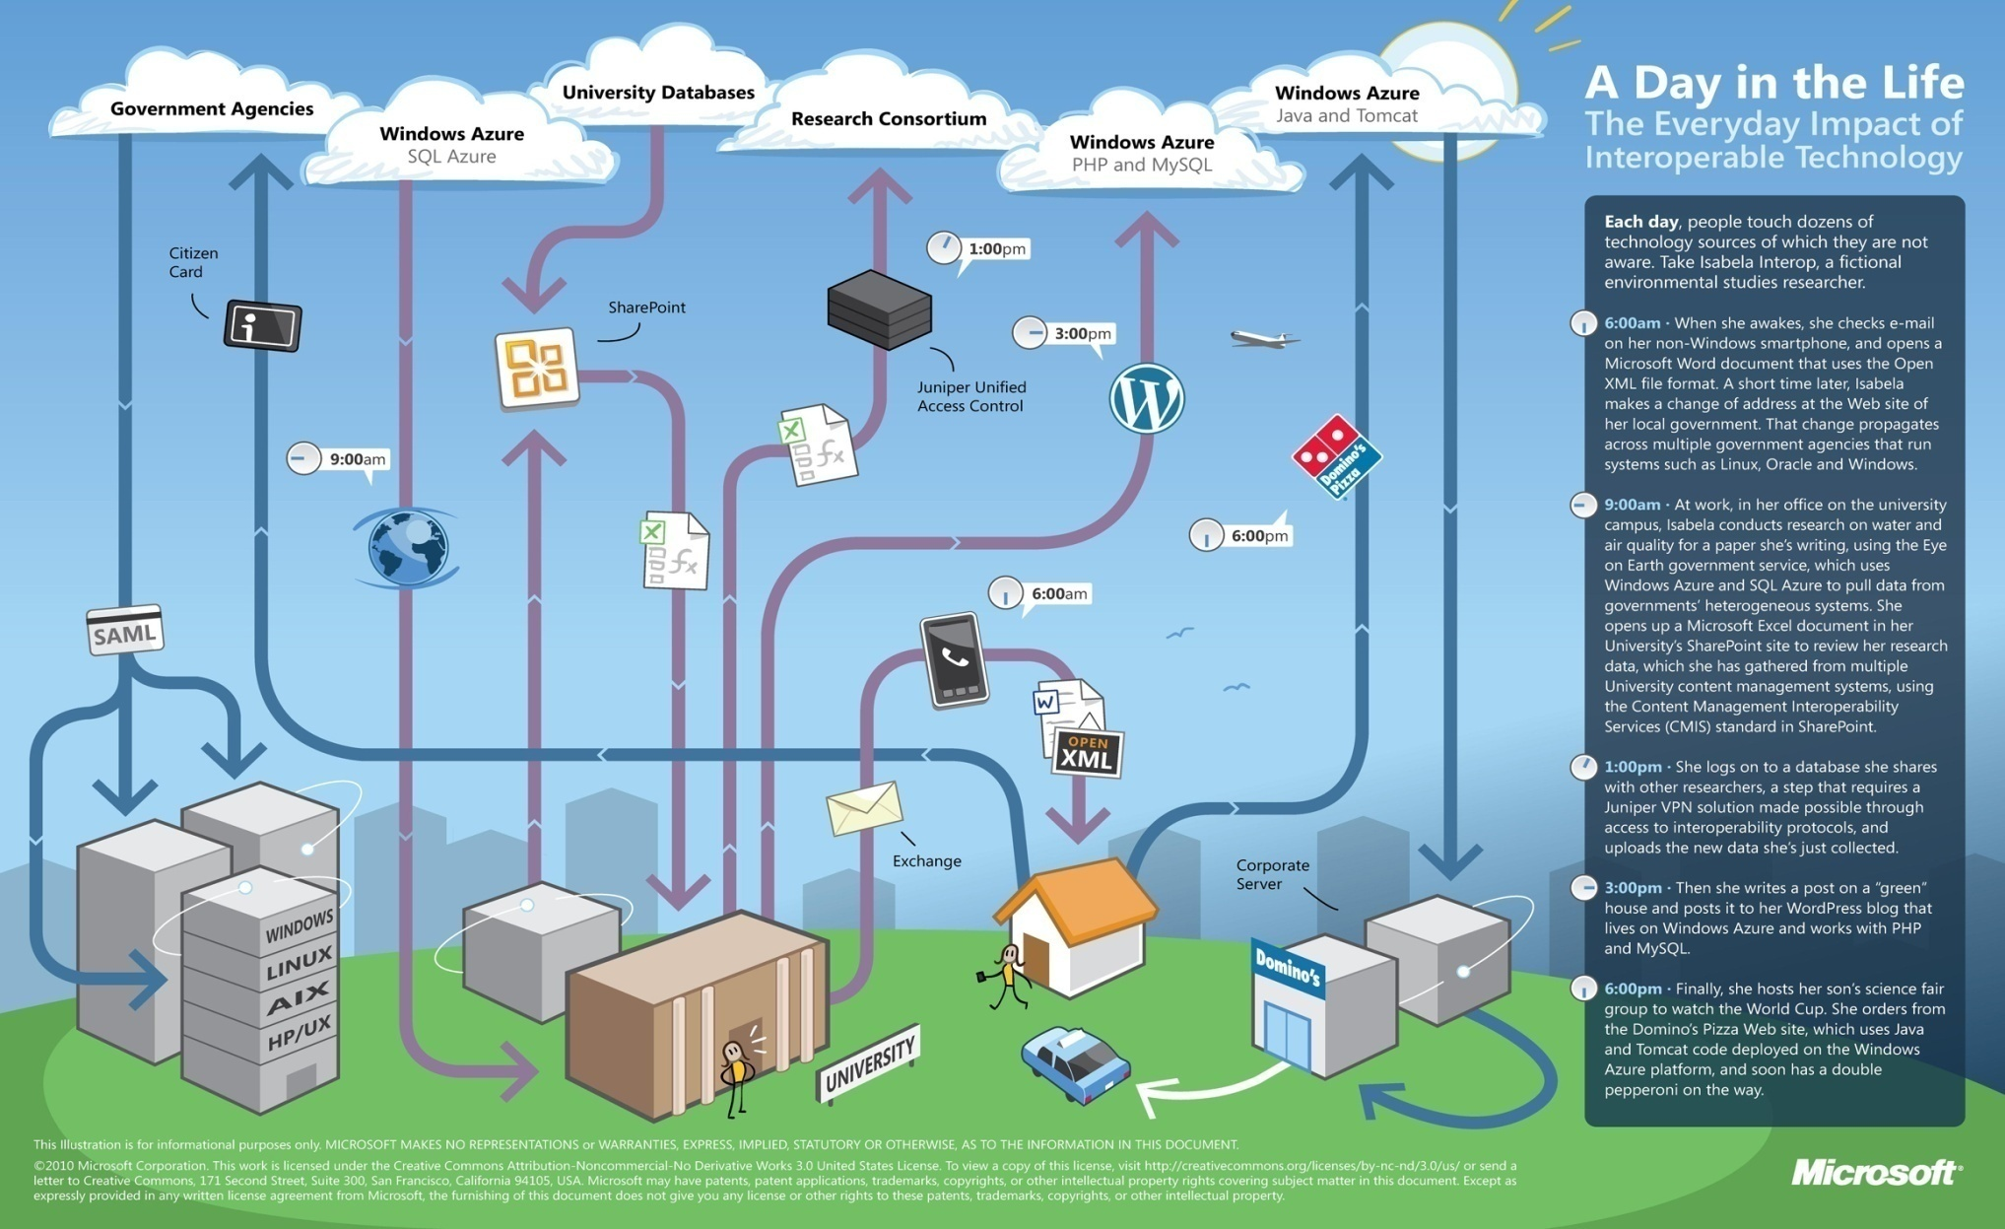
http://news.cnet.com/8301-19413_3-10231290-240.html
http://www.microsoft.com/presspass/features/2010/feb10/02-01cloudinterop.mspx

Slide 24
Web Services take Web-applications to the Next Level
By using Web services, your application can publish its function or message to the rest of the world.
Web services use XML to code and to decode data, and SOAP to transport it (using open protocols).
With Web services, your accounting department's Win 2k server's billing system can connect with your IT supplier's UNIX server.

Slide 25
Web Services have Two Types of Uses
Reusable application-components.
There are things applications need very often. So why make these over and over again?
Web services can offer application-components like: currency conversion, weather reports, or even language translation as services.
Connect existing software.
Web services can help to solve the interoperability problem by giving different applications a way to link their data.
With Web services you can exchange data between different applications and different platforms.

Slide 26
What is SOAP?
SOAP is an XML-based protocol to let applications exchange information over HTTP.
Or more simple: SOAP is a protocol for accessing a Web Service.
SOAP stands for Simple Object Access Protocol
SOAP is a communication protocol
SOAP is a format for sending messages
SOAP is designed to communicate via Internet
SOAP is platform independent
SOAP is language independent
SOAP is based on XML
SOAP is simple and extensible
SOAP allows you to get around firewalls
SOAP is a W3C standard

Slide 27
What is WSDL?
WSDL is an XML-based language for locating and describing Web services.
WSDL stands for Web Services Description Language
WSDL is based on XML
WSDL is used to describe Web services
WSDL is used to locate Web services
WSDL is a W3C standard

Slide 28
What is UDDI?
UDDI is a directory service where companies can register and search for Web services.
UDDI stands for Universal Description, Discovery and Integration
UDDI is a directory for storing information about web services
UDDI is a directory of web service interfaces described by WSDL
UDDI communicates via SOAP
UDDI is built into the Microsoft .NET platform

Slide 29
On Demand Computing
On-demand computing is also known as utility computing.
On-demand (OD) computing is an increasingly popular enterprise model in which computing resources are made available to the user as needed. The resources may be maintained within the user's enterprise, or made available by a service provider.

Slide 30
Companies offering on-demand computing and storage today include Amazon, IBM, Sun, and others.
company operates on a pay-as-you-go plan with a cloud services provider.
Previous - On -demand computing was provided from a single server via some sort of time-sharing arrangement.
Today -the service is based on large grids of computers operating as a single cloud.
On-demand computing itself is not a new concept, but has acquired new life thanks to cloud computing.

Slide 32
Discovering Cloud Services Development Services and Tools

Slide 33
Amazon Elastic Compute Cloud (Amazon EC2)
Amazon Elastic Compute Cloud (Amazon EC2) is a web service that provides resizable compute capacity in the cloud. It is designed to make web-scale computing easier for developers. Amazon EC2’s simple web service interface allows you to obtain and configure capacity with minimal friction. It provides you with complete control of your computing resources and lets you run on Amazon’s proven computing environment. Amazon EC2 reduces the time required to obtain and boot new server instances to minutes, allowing you to quickly scale capacity, both up and down, as your computing requirements change. Amazon EC2 changes the economics of computing by allowing you to pay only for capacity that you actually use. Amazon EC2 provides developers the tools to build failure resilient applications and isolate themselves from common failure scenarios.

Slide 34
Amazon EC2 Functionality
Amazon EC2 presents a true virtual computing environment, allowing you to use web service interfaces to launch instances with a variety of operating systems, load them with your custom application environment, manage your network’s access permissions, and run your image using as many or few systems as you desire.
To use Amazon EC2, you simply:
Select a pre-configured, templated image to get up and running immediately. Or create an Amazon Machine Image (AMI) containing your applications, libraries, data, and associated configuration settings.
Configure security and network access on your Amazon EC2 instance.
Choose which instance type(s) and operating system you want, then start, terminate, and monitor as many instances of your AMI as needed, using the web service APIs or the variety of management tools provided.
Determine whether you want to run in multiple locations, utilize static IP endpoints, or attach persistent block storage to your instances.
Pay only for the resources that you actually consume, like instance-hours or data transfer.

Slide 35
Service Highlights
Elastic
Completely Controlled
Flexible
Designed for use with other Amazon Web Services
Reliable
Secure
Inexpensive

Slide 37
Google App Engine
developers to build their own web applications utilizing the same infrastructure.
integrated application environment.
easy to build, easy to maintain, and easy to scale.

Slide 38
Google offers a robust cloud development environment.
Dynamic web serving
Full support for all common web technologies
Persistent storage with queries, sorting, and transactions
Automatic scaling and load balancing
APIs for authenticating users and sending email using Google Accounts

Slide 42
