Slide 1
UNIT I - UNDERSTANDING CLOUD COMPUTING
Cloud Computing –
History of Cloud Computing –
Cloud Architecture –
Cloud Storage –
Why Cloud Computing
Advantages of Cloud Computing
Disadvantages of Cloud Computing –
Companies in the Cloud Today –
Cloud Services

Slide 2
What is ?
Cloud computing is a technology that uses the internet and central remote servers to maintain data and applications.
A simple example of cloud computing is Yahoo email or Gmail etc
A style of computing where massively scalable (and elastic) IT-related capabilities are provided “as a service” to external customers using Internet technologies

Slide 4
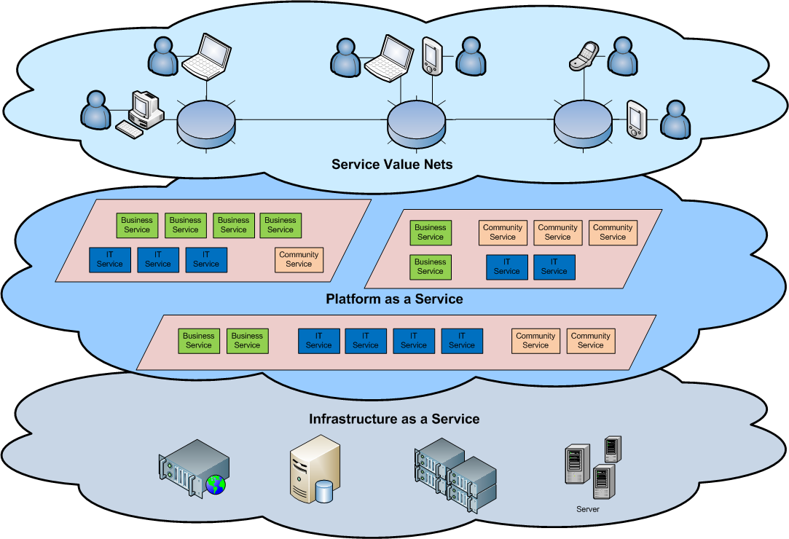
Cloud Architecture
Cloud Architecture

Slide 5
Different Cloud Computing Layers‏
MS Live/ExchangeLabs, IBM,
Google Apps; Salesforce.com
Quicken Online, Zoho, Cisco
Application Service
(SaaS)‏
Google App Engine, Mosso,
Force.com, Engine Yard,
Facebook, Heroku, AWS
Application Platform(PaaS)
Server Platform(IaaS)
3Tera, EC2, SliceHost,
GoGrid, RightScale, Linode
Storage Platform(IaaS)
Amazon S3, Dell, Apple, ...

Slide 6
Cloud Storage
Several large Web companies (such as Amazon and Google) are now exploiting the fact that they have data storage capacity that can be hired out to others.
This approach, known as cloud storage allows data stored remotely to be temporarily cached on desktop computers, mobile phones or other Internet-linked devices.
Amazon’s Elastic Compute Cloud (EC²) and Simple Storage Solution (S3) are well known examples.

Slide 7
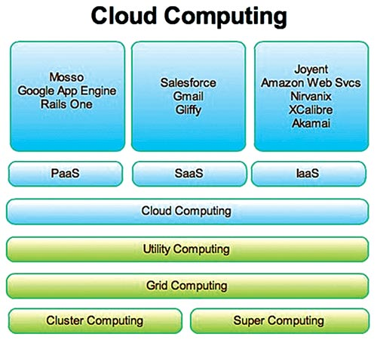

Slide 8
Merits of Cloud Computing
Cost:
Well with all the required software and even hard drives accessible from the cloud, the budget of the business is greatly reduced. There are no infrastructure costs or other Capex (capital expenses). End to expensive servers, routers, etc. When the business is having less or very optimum investment then cloud is the right option. However the expense in cloud scenario is “all or nothing” policy.
Easy to learn and use:
If you have used Gmail, Google Docs, then cloud is nothing new to you. Since the staff would be a well expertise in Gmail and other basic cloud concepts, no special training is required; thereby satisfying the time and the cost constraint. Obviously, now there would no need to hire experienced expensive IT professionals, since this application is a trouble-free one.
Flexibility:
Documents, software, hard drive, storage equipment, etc anything can be accessed from anywhere through cloud; hence no need for the staffs to be office to do the work. Moreover this allows staff to work at anytime thus increasing staff morale.
Maintenance:
No more software updates, reinstalling of applications or even sorting out of software problems since these problems would be sorted out remotely, thus the employee can concentrate more on his/her own work.

Slide 9
Demerits of Cloud computing
Security:
Security is the X-Factor for any business. Just imagine your data being visible to all, or maybe your business strategies visible to all? Negative point, right? That’s what the scenario in cloud computing is; your data will be shared with other companies on the same platform. Of course your cloud vendor will have a higher level of security than the one you have in-house. Still regarding security cloud can’t be rated excellent.
Intellectual property (IP) issues:
There can be a bit chaos as most cloud providers will have different requisites and conditions regarding tenure of the data. To overcome this demerit, you must have read the fine print and understand things like when can you access your data, what happens to your data is your vendor ebbs, distribution rights, etc initially. Also keep an eye on the rules to know whether breach of any kind may occur for your IP.
Wireless connections:
Connecting to wireless devices is not the easiest task to do. This problem is for small scale industries rather than larger business since larger companies have well structured network thus making wireless connections easy. Sometimes certain softwares are designed to relate to certain PCs alone in that case even usage of software maybe a problem.
Performance and Reliability:
Since everything you access is online, there might be a risk in CIA parameters (Confidentiality, Integrity, and Availability). Moreover the speed of your process depends on the speed of the network (when there is network traffic, the speed of our process may collapse). Additionally there can be noise in the media if any major application is down. In order to overcome this you must review the SLA (Service Level Agreement).

Slide 10
Who Benefits from Cloud Computing
Collaborators
Road Warriors
Cost-Conscious Users
Cost-Conscious IT Departments
Users with Increasing Needs

Slide 11
Top Cloud Service Providers
With that M&A activity as background, here are my rankings for the Top 30 Cloud Service Providers Gaining Mind Share in 3Q 2010.
Amazon Web Services (AWS), Elastic Compute Cloud (EC2), Simple Storage Service (S3), andVirtual Private Cloud (VPC)
Salesforce.com / Sales Cloud 2 (CRM), Service Cloud 2 (Support),Force.com (Development Platform), Chatter (Collaboration)
Google Apps (AppEngine)
Citrix – XenServer (Virtualization)
VMWare – vSphere (Virtualization)
Rackspace – Mosso
3PAR
Cisco
IBM Smart Business, Cloudburst
AT&T Synaptic

Slide 12
Verizon rPath
Appistry Rightscale (#7 management)
Joyent GoGrid
3Tera – AppLogic Microsoft Azure, Hyper-V
NetSuite Zuora
Eucalyptus CohesiveFT
Boomi Red Hat
Appirio – Cloud Connectors
Relational Networks – LongJump AppZero
Enomaly – Elastic Compute Platform (ECP)
Intacct Elastra

Slide 13
Some Commercial Cloud Offerings

Slide 14
Cloud Computing Service Layers
Services
Description
Services
Services – Complete business services such as PayPal, OpenID, OAuth, Google Maps, Alexa
Application
Focused
Application
Application – Cloud based software that eliminates the need for local installation such as Google Apps, Microsoft Online
Development
Development – Software development platforms used to build custom cloud based applications (PAAS & SAAS) such as SalesForce
Platform
Platform – Cloud based platforms, typically provided using virtualization, such as Amazon ECC, Sun Grid
Storage
Infrastructure
Focused
Storage – Data storage or cloud based NAS such as CTERA, iDisk, CloudNAS
Hosting
Hosting – Physical data centers such as those run by IBM, HP, NaviSite, etc.

